Slide 1
SpillNY
Final
Project
Saba Syed
16:137:552 - Python Methodologies

Slide 2
Summary of Contents
Introduction
Dataset
Custom Library
Iteration and Decision Making
Imports from Library
File Input
File Output
Data Structure
Object Orientation

Slide 3
SpillNY
Python Methodologies
Introduction: SpillNY is simple tool that will transform data into a clear graph. This project will generate a graph using Python and the use of Matlibplot to visualize the data and to create a summary for the question mentioned in the project proposal.
Where are the spills?
What is the most types of spills?

Slide 4
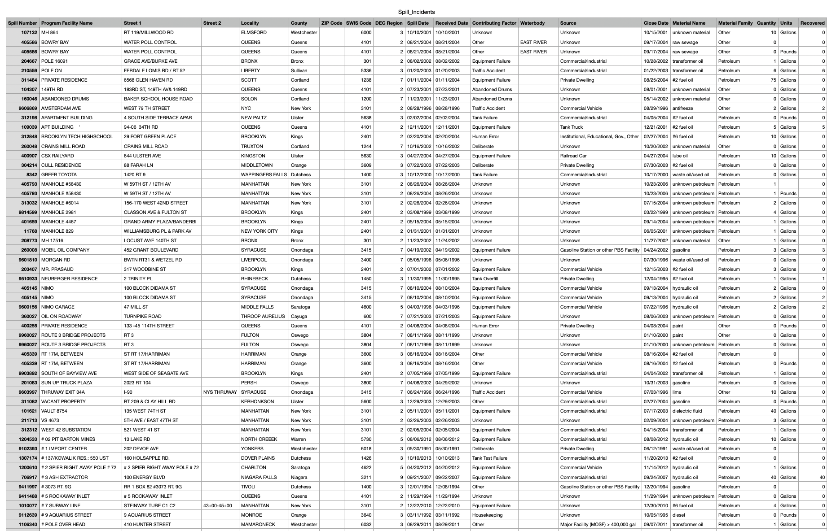
Dataset
SpillNY
Python Methodologies
The dataset sourced from the New York State Department of Environment Conservation link is below
https://data.ny.gov/Energy-Environment/Spill-Incidents/u44d-k5fk/about_data
Saved as Spill_Incidents.csv in my Final Python folder
Dataset has 250,000 records of data regarding spills in New York.

Slide 5
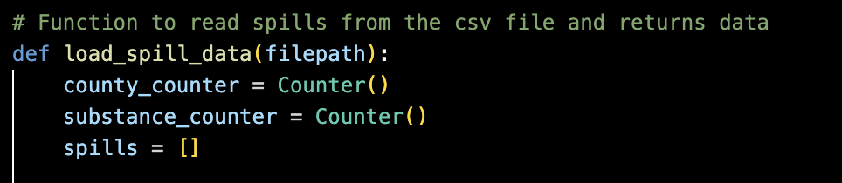
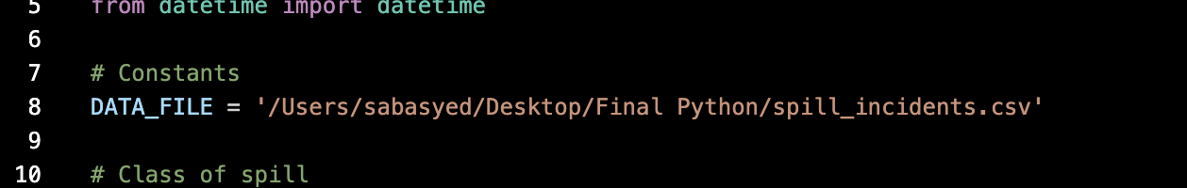
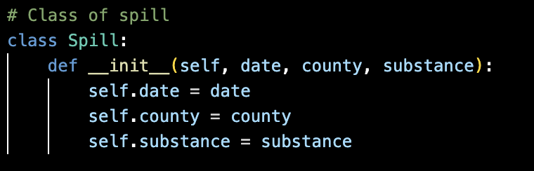
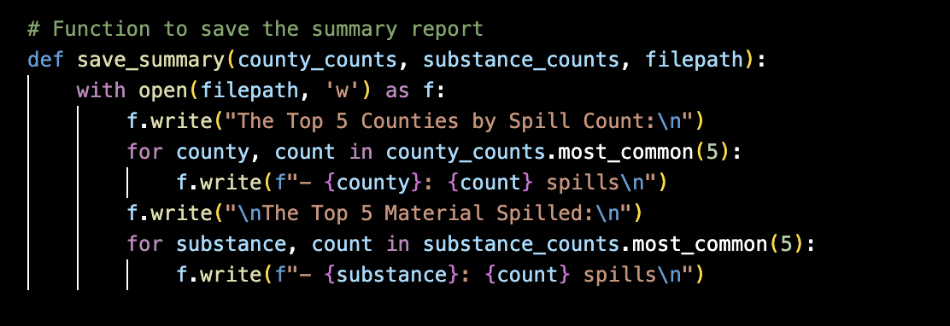
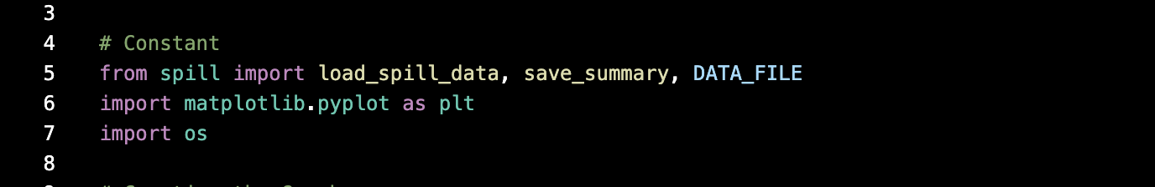
Custom Library
SpillNY
Python Methodologies
Spill.py contains the classes, functions, and constants which organizes the project.
Constants is also used in main.py.
Functions
Constants
Classes

Slide 6
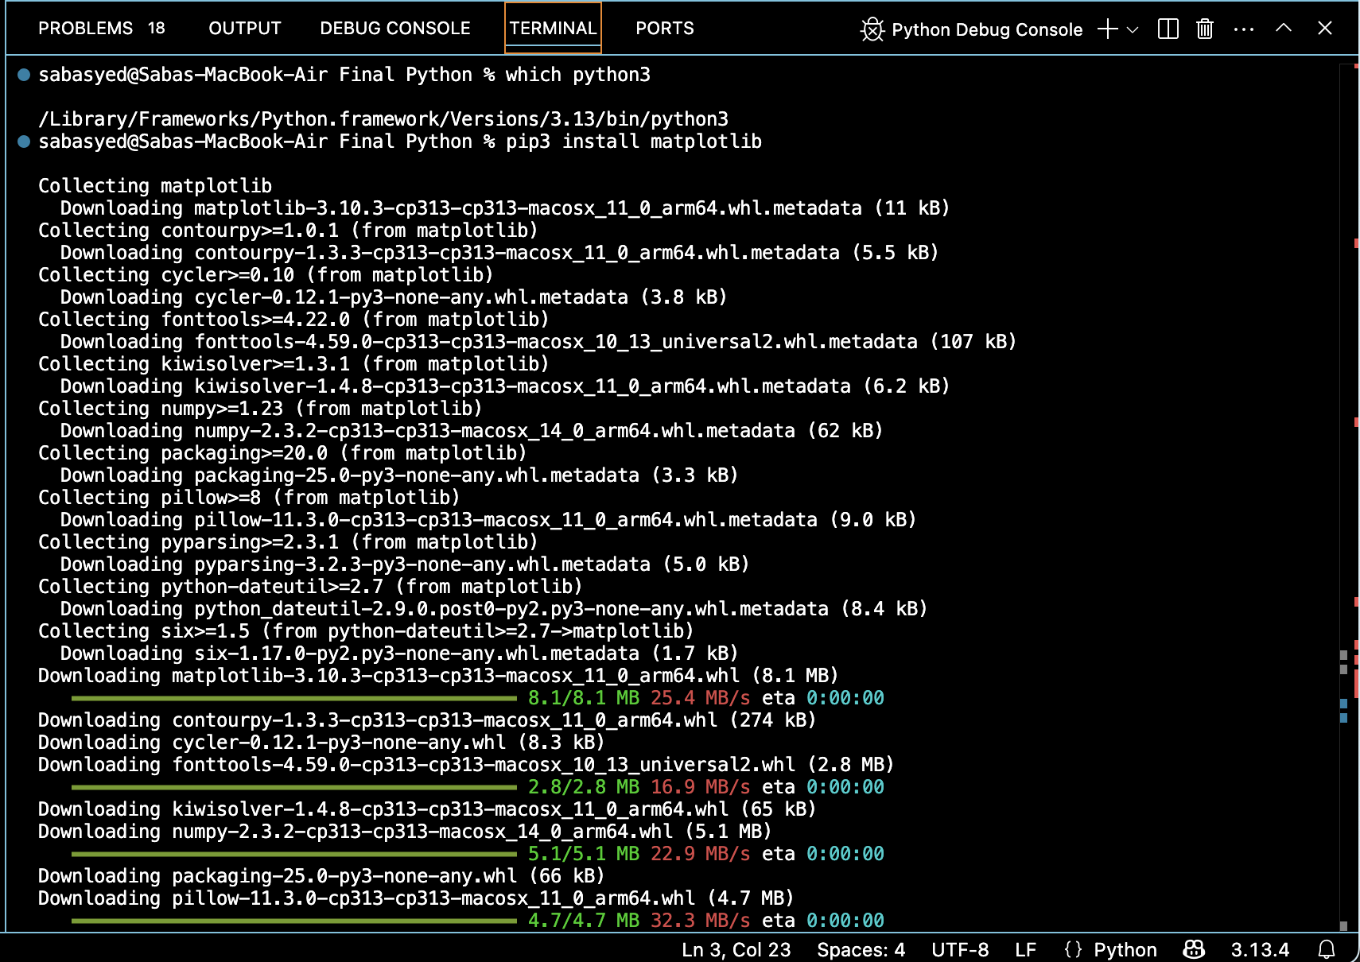
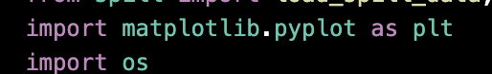
SpillNY
Python Methodologies
Imports from a third party library: Matplotlib
I added matplotlib to my project since it built in features that I needed to create the graph which made it easier for me to use. I also had to add it to my terminal first before including it into my project since I needed it on my computer. The way I downloaded it to visual studios is by confirming my python is up to date and then installing matplotlib.

Slide 7
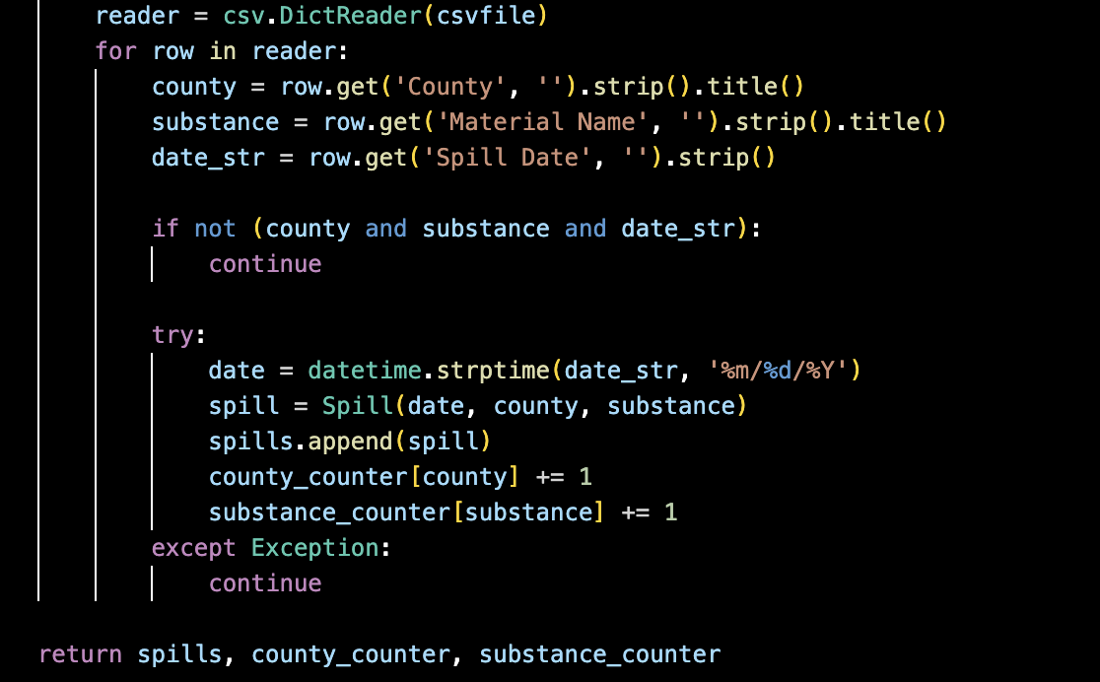
Iteration: Using Loops
SpillNY
Python Methodologies
I added loops through the data in the csv. The loop in this case is the for row in reader because my program is reading a csv file which will loop the county, substance, and date.

Slide 8
Decision Making: Using if, try, except
SpillNY
Python Methodologies
I used decision logic to filter the county, substance, and date. The county, substance, and date will return the spills, county number and substance number to form a decision and rank the counties based on amount.

Slide 9
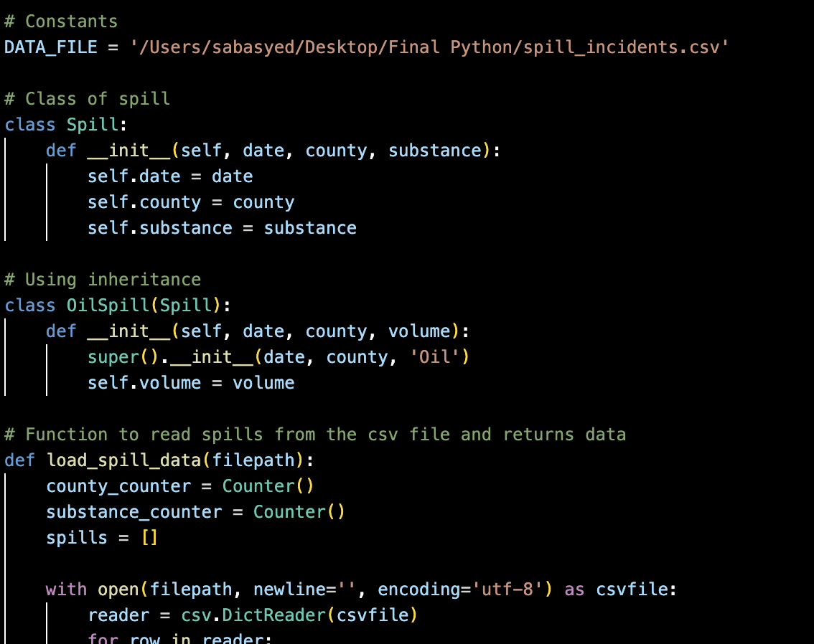
File Input
SpillNY
Python Methodologies
The file input is found through the constant DATA_FILE which is used again in the function to read the csv file.

Slide 10
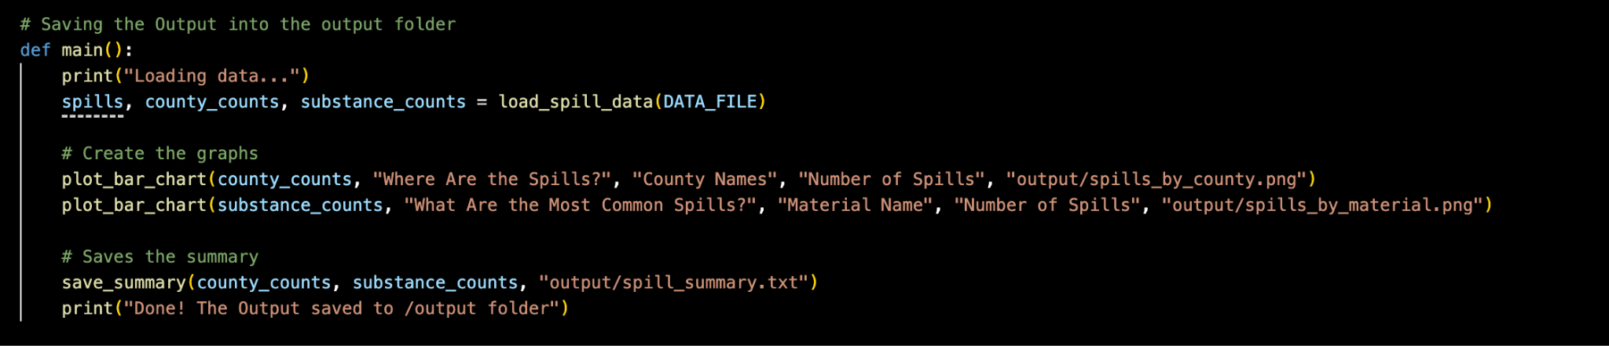
File Output
SpillNY
Python Methodologies
The file output is png files and a text file of the report which can be found in the output folder.

Slide 11
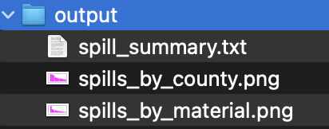
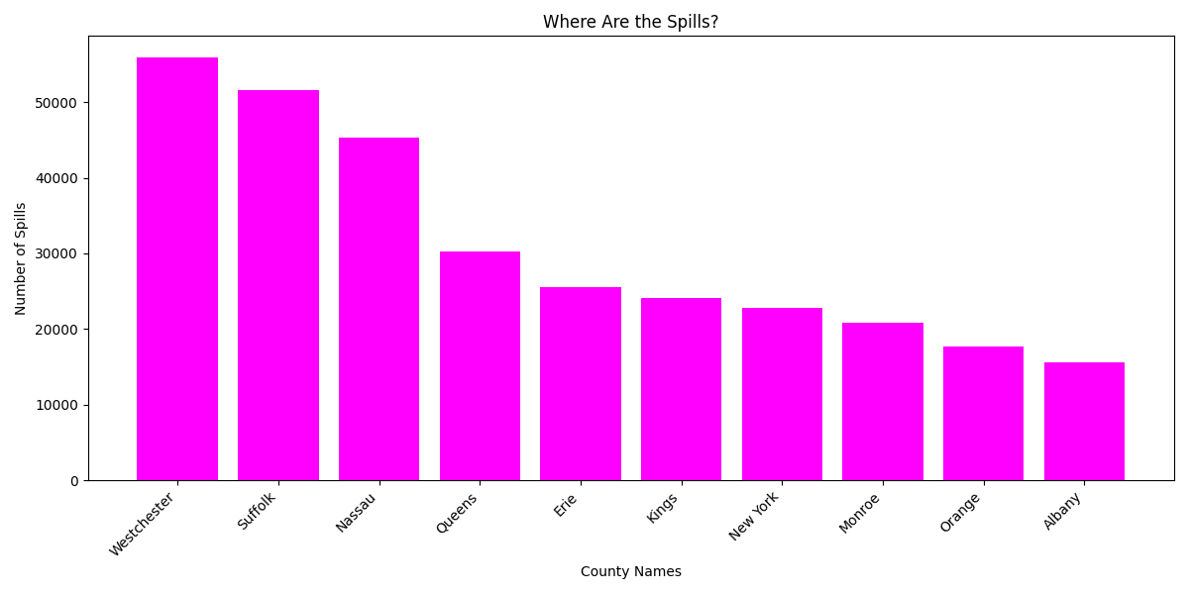
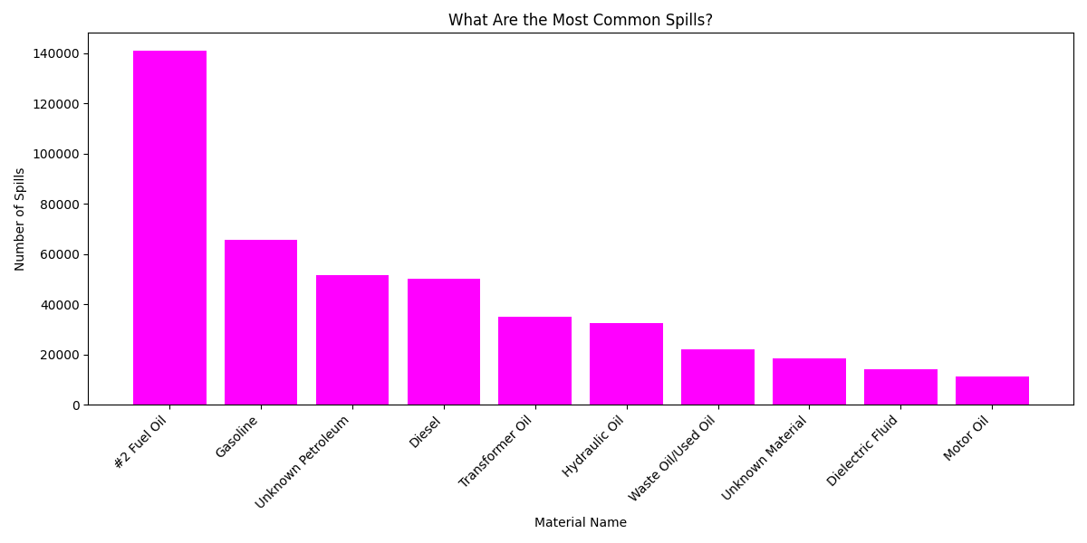
File Output
SpillNY
Python Methodologies
The Top 5 Counties by Spill Count:
- Westchester: 55970 spills
- Suffolk: 51636 spills
- Nassau: 45317 spills
- Queens: 30205 spills
- Erie: 25581 spills
The Top 5 Material Spilled:
- #2 Fuel Oil: 141005 spills
- Gasoline: 65574 spills
- Unknown Petroleum: 51706 spills
- Diesel: 50126 spills
- Transformer Oil: 35014 spills

Slide 12
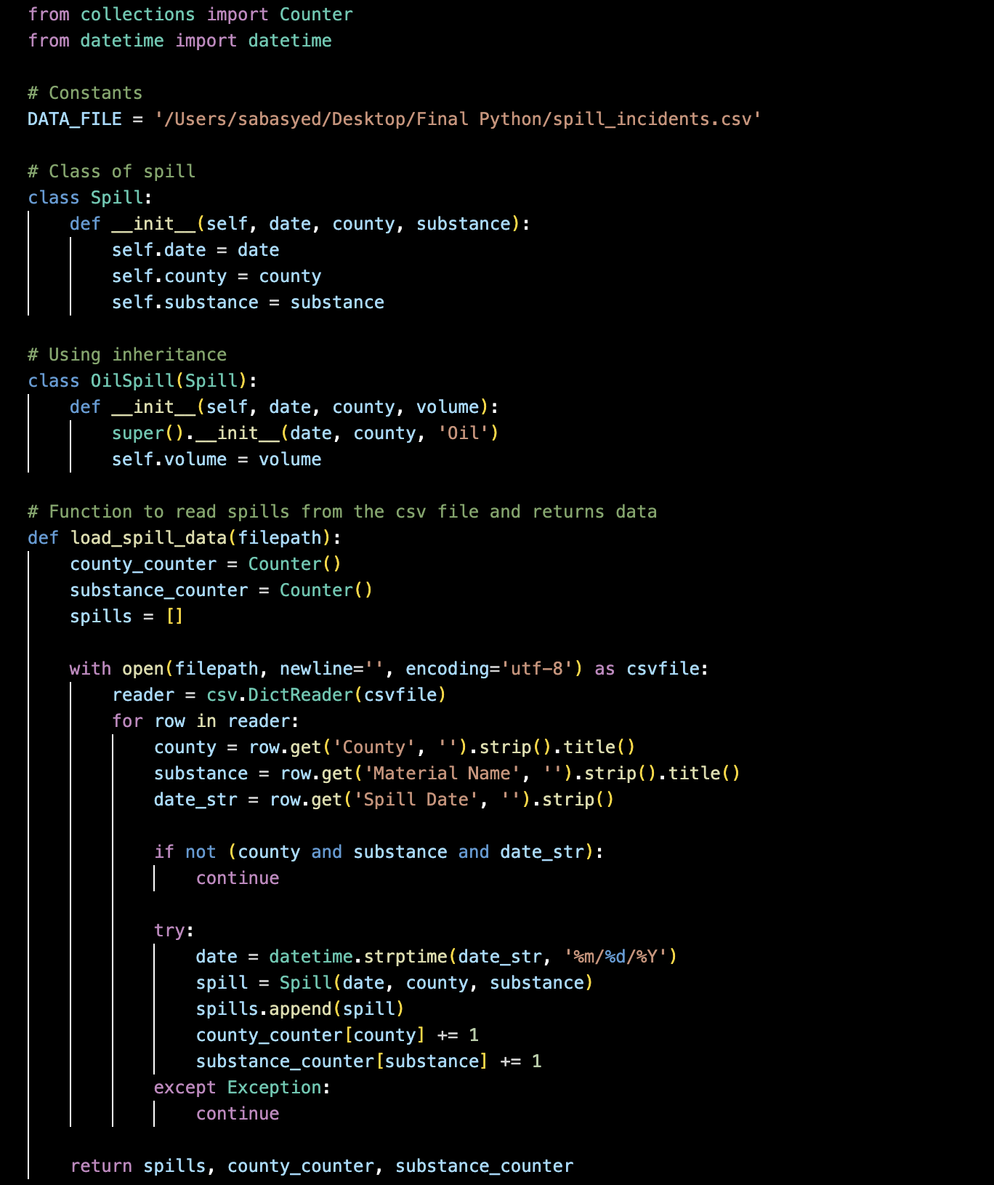
Use of Data Structures
SpillNY
Python Methodologies
Dict
For dict, I used counter to count the number of spills by counties and substances.
Lists
For lists, I used spills to store all spills objects from the csv file.

Slide 13
SpillNY
Python Methodologies
Use of Object Orientation
Inheritance
I used Spill and OilSpill classes to create an inheritance. The main class is Spill which contains the date, county, substance. The second class OilSpill inherits from Spill. This helps organize my project and avoid duplicates.

Slide 14
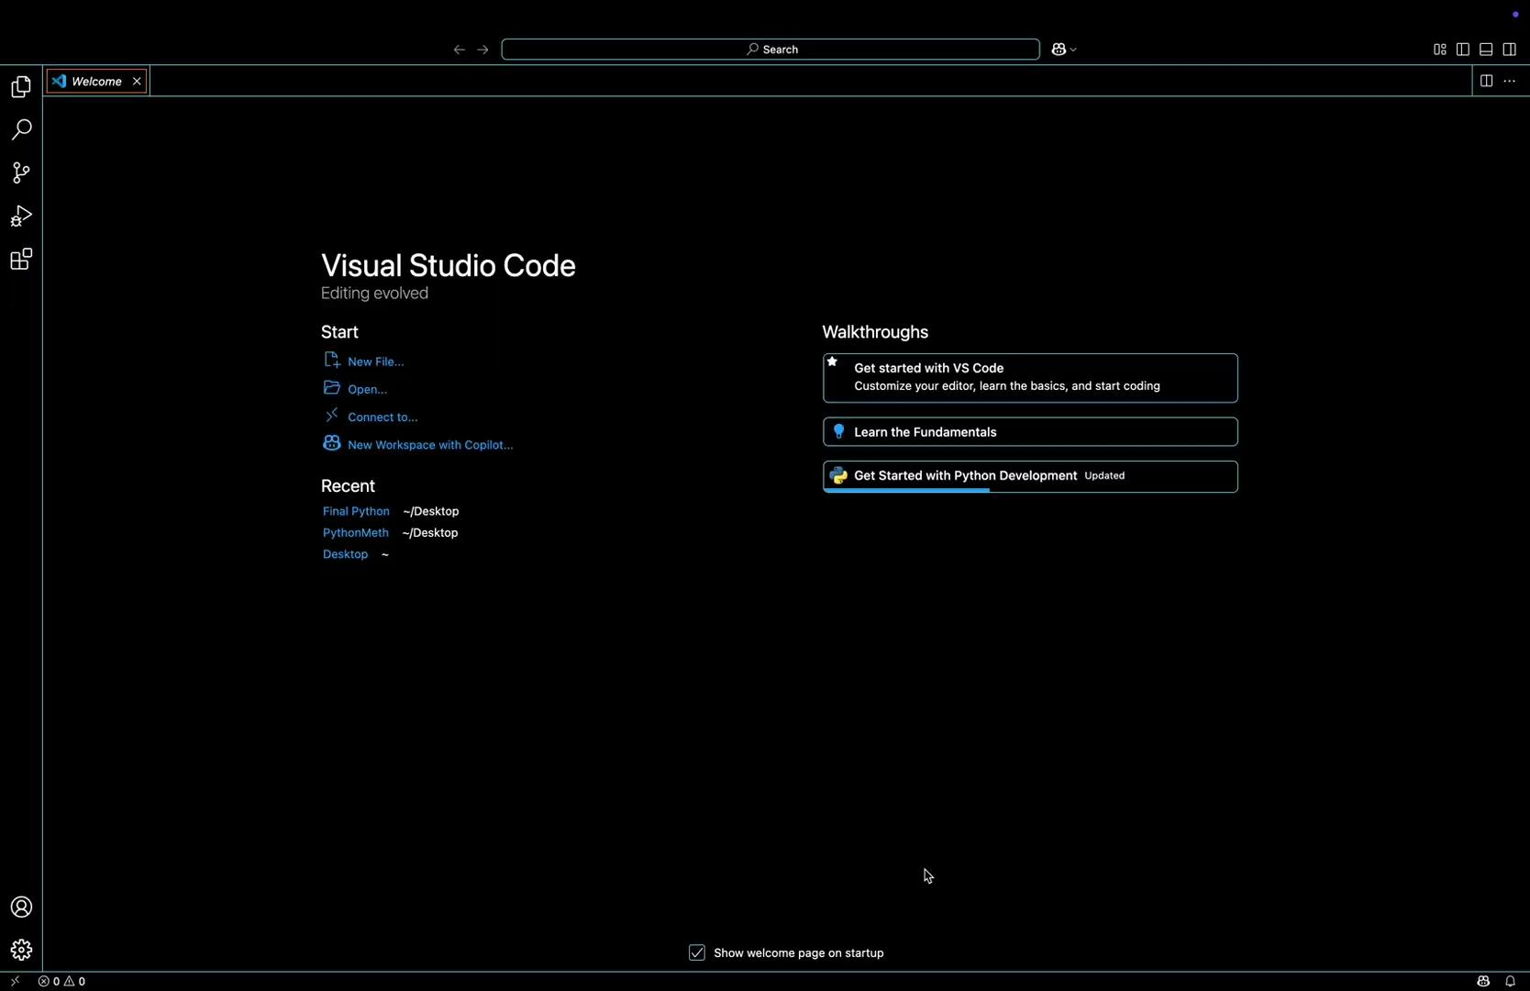
Demo Video

Slide 15

Thank you!
Questions? Contact
email

